Slide 1
HEART FAILURE PREDICTION

Slide 2
Introduction
This dataset was created by combining different datasets already available independently but not combined before.
In this dataset, 5 heart datasets are combined over 11 common features which makes it the largest heart disease dataset available so far for research purposes.
People with cardiovascular disease or who are at high cardiovascular risk need early detection and management wherein a machine learning model can be of great help.

Slide 3
ATTRIBUTE INFORMATION
COLUMNS | DESCRIPTION
Age | : age of the patient [years]
Sex | : sex of the patient [M: Male, F: Female]
ChestPainType | : chest pain type [TA: Typical Angina, ATA: Atypical Angina, NAP: Non-Anginal Pain, ASY: Asymptomatic]
RestingBP | : resting blood pressure [mm Hg]
Cholesterol | : serum cholesterol [mm/dl]
FastingBS | : fasting blood sugar [1: if FastingBS > 120 mg/dl, 0: otherwise]
RestingECG | :resting electrocardiogram results [Normal: Normal, ST: having ST-T wave abnormality, LVH: showing probable or definite left ventricular hypertrophy by Estes' criteria]
MaxHR | : maximum heart rate achieved [Numeric value between 60 and 202]
ExerciseAngina | : exercise-induced angina [Y: Yes, N: No]
Oldpeak | : oldpeak = ST [Numeric value measured in depression]
ST_Slope | : the slope of the peak exercise ST segment [Up: upsloping, Flat: flat, Down: downsloping]
HeartDisease | : output class [1: heart disease, 0: Normal]

Slide 4
FEATURES AND PREPROCESSING
In this dataset there is no null values and the values among the columns also not correlated .
Using pandas.dummies I converted the text data into numerical data .
There were 918 rows and 16 columns after completing Preprocessing .

Slide 5
Splitting Data
Here I used KFold, StratifiedKFold and train_test_split method .
Kfold - 10 splits
StratifiedKFold - 10 splits
train_test_split – 70:30

Slide 6
MODEL Used
Here I used below models to predict output :
Decision Tree
Random Forest (600 estimators)
Logistic Regression (1000 iterations)
Naïve bayes
Out of which , Random Forest and Logistic regression with Train-Test-Split method gave better accuracy .

Slide 7
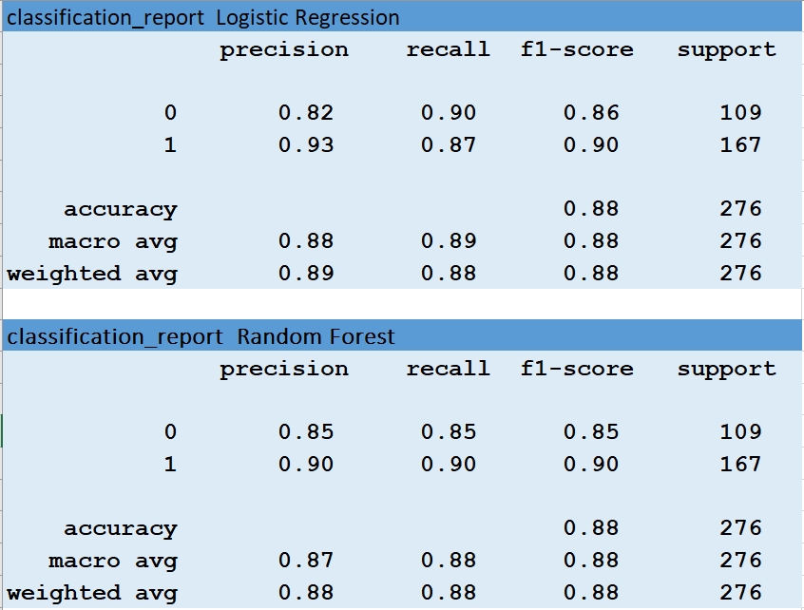
Classification Report

